Slide 1
PCET’S NUTAN COLLEGE OF ENGINEERING & RESEARCH (NCER)
Subject
Discrete Mathematics
Presented by: Tejaswini Zope

Slide 2
UNIT 1 Fundamental Structures and Basic Logic

Slide 3
1.Set:
Set is the most basic terms in mathematics. The theory of sets was introduces by the German mathematical G. Cantor who defines a set as collection of objects.
Defination:
1. A set is defined as a collection of distinct objects of the same type or class of objects.
2.The object of set are called elements or members of the sets. Object can be Numbers, Alphabets, Names etc.
For eg : A = {1,2,3,4,5}
3. Set is usually denote by the capital letter A, B, C, etc.
P={a,b,c}

Slide 4
1.1.Representation of a Set
Sets can be represented in two ways −
1.Roster or Tabular Form –
2. Builder form of set –
1.Roster or Tabular Form -
If a set is define by listing it’s members called tabular form.
The elements are enclosed within braces and separated by commas.
For eg− if Set P contain elements a,b,c then it’s express as P={a,b,c}
2. Builder form of set –
When the element or member of set satisfy some properties then its called as builder set.
For eg: P = {x:x ∈ to N, x is multiple of 5}

Slide 5
1.2.Set Notation:
x ∈ A - x belongs to A or x is an element of set A.
x ∉ A - x does not belong to set A.
∅ - Empty Set
U- Universal Set.
N - The set of all natural numbers.
I - The set of all integers.
I₀ - The set of all non- zero integers.
I₊ - The set of all + ve integers.

Slide 6
1.3. Types of Sets
1.Equality of set:
Two sets A & B are equal if and only if A and B contain the same elements or both are elements empty.
A=B
2.Empty Set :
A set which contain no elements is called as empty set.
3.Subset:
A set ‘A’ is a subset of set ‘B’ if and only if elements of A is an elements of ‘B’
If A is subset of B then we can written it as,
A⊆ B

Slide 7
4.Proper Subset:
If A ⊆ B and A≠B then A is called a proper subset of B and it is Written as A ⊂ B
For eg: 1. Let A = {2, 3, 4} B = {2, 3, 4, 5}
A is a proper subset of B.
2. The null ∅ is a proper subset of every set.
5.Power Set:
It is denoted by P(A)
The set of all Subset of A is called power set
For eg- If A={a,b,c} then
P(A) ={∅,{a}, {b}, {c},{a,b},{b,c},{a,c},{a,b,c}}

Slide 8
1.4.Operation on set
Union of Sets:
Union of Sets A and B is defined to be the set of all those elements which belong to A or B or both and is denoted by A∪B.
A∪B = {x: x ∈ A or x ∈ B}
For eg- Let A = {1, 2, 3}, B= {3, 4, 5, 6} A∪B = {1, 2, 3, 4, 5, 6}
2. Intersection of Sets:
Intersection of two sets A and B is the set of all those elements which belong to both A and B and is denoted by A ∩ B.
A ∩ B = {x: x ∈ A and x ∈ B}
For eg- Let A = {11, 12, 13}, B = {13, 14, 15} A ∩ B = {13}.

Slide 9
3. Difference of Sets:
The difference of two sets A and B is a set of all those elements which belongs to A but do not belong to B and is denoted by A - B.
A - B = {x: x ∈ A and x ∉ B}
For eg- Let A = {1, 2, 3, 4} and B = {3, 4, 5, 6} then A - B = {1,2} and B - A = {5, 6}
4. Complement of a Set:
The Complement of a Set A is a set of all those elements of the universal set which do not belong to A and is denoted by A^{c}.
A^{c} = U - A = {x: x ∈ U and x ∉ A} = {x: x ∉ A}
Let U is the set of all natural numbers. A = {1, 2, 3} A^{c} = {all natural numbers except 1, 2, and 3}.

Slide 10

2.Venn Diagrams
Venn diagram, invented in 1880 by John Venn, is a schematic diagram that shows all possible logical relations between different mathematical sets.
1.Union of sets
The union of sets A and B (denoted by A∪BA∪B) is the set of elements which are in A, in B, or in both A and B.
A∪B = {x: x ∈ A or x ∈ B}
eg- If A={10,11,12,13} and B = {13,14,15}, then A∪B={10,11,12,13,14,15}

Slide 11
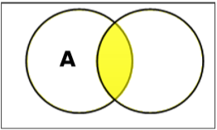
2.Intersection of set-
The intersection of sets A and B (denoted by A∩BA∩B) is the set of elements which are in both A and B.
A∩B={x|x∈A AND x∈B} eg- If A={11,12,13}and
B={13,14,15}, then A∩B={13}.

Slide 12
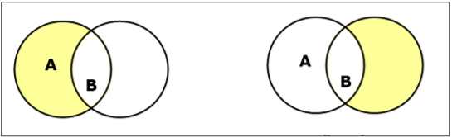
3.Set Difference/ Relative Complement The set difference of sets A and B (denoted by A–B) is the set of elements which are only in A but not in B. A−B={x|x∈A AND x∉B}.
Eg-If A={10,11,12,13} and B={13,14,15},
then (A−B)={10,11,12}
and (B−A)={14,15}. Here, we can see (A−B)≠(B−A)

Slide 13
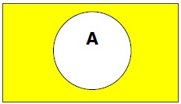
4.Complement of a Set- The complement of a set A (denoted by A′) is the set of elements which are not in set A. A′={x|x∉A}. A′=(U−A) where U is a universal set which contains all objects. If A={x|x belongs to set of odd integers} then A′={y|y does not belong to set of odd integers}

Slide 14
3.Cartesian Product / Cross Product
The Cartesian product of n number of sets A1,A2,…An denoted as A1×A2⋯×An can be defined as all possible ordered pairs (x1,x2,…xn) where x1 ∈ A1, x2 ∈ A2,… xn ∈ An
Eg- If we take two sets A={a,b} and B={1,2}, The Cartesian product of A and B is written as − A×B={(a,1),(a,2),(b,1),(b,2)} The Cartesian product of B and A is written as − B×A={(1,a),(1,b),(2,a),(2,b)}

Slide 15
4.Power Set Power set of a set S is the set of all subsets of S including the empty set. The cardinality of a power set of a set S of cardinality n is 2^{n}. Power set is denoted as P(S). Eg- For a set S={a,b,c,d}
calculate the subsets − Subsets with 0 elements − {∅}(the empty set) Subsets with 1 element − {a},{b},{c},{d} Subsets with 2 elements − {a,b},{a,c},{a,d},{b,c},{b,d},{c,d} Subsets with 3 elements − {a,b,c},{a,b,d},{a,c,d},{b,c,d} Subsets with 4 elements − {a,b,c,d} Hence, P(S)= {{∅},{a},{b},{c},{d},{a,b},{a,c},{a,d},{b,c},{b,d},{c,d},{a,b,c},{a,b,d},{a,c,d},{b,c,d},{a,b,c,d}} |P(S)|=2⁴=16
5.Cardinality
The cardinality of a set is a measure of a set's size, meaning the number of elements in the set. The number is also referred as the cardinal number.
For Example:The set A={1,2,4 } has a cardinality of 3 for the three elements that are in it
For a set A, its cardinality is denoted by |A| or n(A)

Slide 16
Two finite sets are considered to be of the same size if they have equal numbers of elements. Two finite sets A and B to have the same cardinality if and only if there exists a bijection A→B.
For finite sets, these two definitions are equivalent. A bijection will exist between A and B only when elements of A can be paired in one-to-one correspondence with elements of B, which necessarily requires A and B have the same number of elements.
5.1.Countability
What does it mean to say that a set is countable?
Counting just means matching each member of the ordered set with a unique member of the set of counting numbers, which are usually taken to be N⁺, the positive natural numbers: 1, 2, 3, .... (Some weird mathematicians and computer scientists count starting with 0, i.e., by using N, the natural numbers: 0, 1, 2, 3, ....

Slide 17
6.Propositional Logic
A proposition is a collection of declarative statements that has either a truth value "true” or a truth value "false". A propositional consists of propositional variables and connectives. We denote the propositional variables by capital letters (A, B, etc). The connectives connect the propositional variables.
Some examples of Propositions are given below −
1)1+1=2 --------True
2) London is in Denmark---False
The following is not a Proposition −
1)Where are you going ?
2)Sit down.
Here in 1st statement is question and 2nd is command

Slide 18
7.Logical Connectives
A logical connectives is a symbol which is used to connect two or more proposaltional logics in such a manner that resultant logic depends only on the input logics.
1)Negation/ NOT (~):
The negation of a proposition A (written as ¬A or ~A) is false when A is true and is true when A is false.
The truth table is as follows −
A | ~ A
True | False
False | True

Slide 19
2)Conjuction(AND (∧)):
The AND operation of two propositions A and B (written as A∧B) is true if both the propositional variable A and B is true.
The truth table is as follows −
A | B | A ∧ B
True | True | True
True | False | False
False | True | False
False | False | False

Slide 20
3)Disjunction (OR (∨)):
The OR operation of two propositions A and B (written as A∨B) is true if at least any of the propositional variable A or B is true.
The truth table is as follows −
A | B | A ∨ B
True | True | True
True | False | True
False | True | True
False | False | False

Slide 21
4) Implication (conditional) (→):
An implication A→B is the proposition “if A, then B”. It is false if A is true and B is false. The rest cases are true.
The truth table is as follows −
A | B | A → B
True | True | True
True | False | False
False | True | True
False | False | True

Slide 22
5)Biconditional(Double implication)(⇔) :
A⇔B is bi-conditional logical connective which is true when p and q are same, i.e. both are false or both are true.
The truth table is as follows −
A | B | A ⇔ B
True | True | True
True | False | False
False | True | False
False | False | True

Slide 23
7.1.Logical connectives:-
A Logical Connective is a symbol which is used to connect two or more propositional or predicate logics in such a manner that resultant logic depends only on the input logics and the meaning of the connective used.
Generally there are five connectives which are −
OR (∨)
AND (∧)
Negation/ NOT (¬)
Implication / if-then (→)
If and only if (⇔).

Slide 24
1.Conjunction(“AND”)
If p and q are the statement the compound statement “p and q” is called as the conjunction of p and q and is denoted by p ^ q
Lets consider the statements
p: the sun is shining
q: the birds are singing
Then p^q is the statement “ the sin is shining and the birds are singing.”
2) p: 2 is a prime number.
q: ram is an intelligent boy.
Then p^q is the statement “ ”
3) Translate into symbolic form the statement
Amar is poor but happy.
Solu^{n} : p: Amar is poor.
q: Amar is happy.

Slide 25
2.Disjunction(“OR”)
If p and q are statement , then the compound statement “p and q” is called as the disjunction of p and q , and is denoted by “p ∨ q”.
There is an error in the program or the data is wrong.
p: there is an error in the program.
q: the data is wrong
Then p ∨ q: There is an error in the program or the data is wrong.
3.Conditional(“If… then”)
If p and q statement the compound statement “If p then q”, denoted by “p->q” is called conditional statement or implication.
P is called antecedent or hypothesis while q is called the consequent.

Slide 26
4.Biconditional (“If and only if”)
If p and q are statements, the compound statement “p if and only if q”, denoted by p<->q is called a bi conditional statement.
An integer is even if and only if it is divisible by 2.
8.Normal Forms
We can convert any proposition in two normal forms −
Conjunctive normal form
Disjunctive normal form
1.Conjunctive normal form
A compound statement is in conjunctive normal form if it is obtained by operating AND among variables (negation of variables included) connected with ORs. In terms of set operations, it is a compound statement obtained by Intersection among variables connected with Unions.

Slide 27
Examples
(A∨B)∧(A∨C)∧(B∨C∨D)
(P∪Q)∩(Q∪R)
2. Disjunctive Normal Form
A compound statement is in disjunctive normal form if it is obtained by operating OR among variables (negation of variables included) connected with ANDs. In terms of set operations, it is a compound statement obtained by Union among variables connected with Intersections.
Examples
(A∧B)∨(A∧C)∨(B∧C∧D)
(P∩Q)∪(Q∩R)

Slide 28
3.Principle Conjunctive Normal Form (PCNF) : An equivalent formula consisting of conjunctions of maxterms only is called the principle conjunctive normal form of the formula.
It is also known as product-of-sums canonical form.
Example : (P ∨ ~ Q ∨ ~ R) ∧ (P ∨ ~ Q ∨ R) ∧ (~ P ∨ ~ Q ∨ ~ R)
The maxterm consists of disjunctions in which each variable or its negation, but not both, appears only once.
The dual of a minterm is called a maxterm.
Each of the maxterm has the truth value F for exactly one combination of the truth values of the variables.
The maxterms are written down by including the variable if its truth value is F and its negation if its truth value is T.

Slide 29
4.Principle Disjunctive Normal Form (PDNF) : An equivalent formula consisting of disjunctions of minterms only is called the principle disjunctive normal form of the formula.
It is also known as sum-of-products canonical form.
Example : (P ∧ ~ Q ∧ ~ R) ∨ (P ∧ ~ Q ∧ R) ∨ (~ P ∧ ~ Q ∧ ~ R)
The minterm consists of conjunctions in which each statement variable or its negation, but not both, appears only once.
The minterms are written down by including the variable if its truth value is T and its negation if its truth value is F.

Slide 30
9.Validity
The validity of a logical argument refers to whether or not the conclusion follows logically from the premises, i.e., whether it is possible to deduce the conclusion from the premises and the allowable syllogisms of the logical system being used. If it is possible to do so, the argument is said to be valid; otherwise it is invalid. A classical example of a valid argument is the following:
1) All men are mortal.
Socrates is a man.
Therefore Socrates is mortal.
Truth and validity are different notions. An argument may be valid and yet the conclusion may be false if one or more of the premises is false, as the following example shows:
2)All men are registered voters.
Moby Dick is a man.
Therefore Moby Dick is a registered voter.

Slide 31
On the other hand, an argument may be invalid and yet the conclusion may be true, as the following example shows:
3) All men are mortal.
Oxygen is a chemical element.
Therefore, some men can run a mile in four minutes.
Mathematical proofs are also said to be valid or invalid. A mathematical proof is valid if the conclusion follows from the assumptions by applying legal mathematical operations to arrive at the conclusion.
10.Predicate Logic –
Definition
A predicate is an expression of one or more variables defined on some specific domain. A predicate with variables can be made a proposition by either assigning a value to the variable or by quantifying the variable.
The following are some examples of predicates −
Let E(x, y) denote "x = y"
Let X(a, b, c) denote "a + b + c = 0"
Let M(x, y) denote "x is married to y"

Slide 32
11.Quantifiers
The variable of predicates is quantified by quantifiers. There are two types of quantifier in predicate logic − Universal Quantifier and Existential Quantifier.
Universal Quantifier
Universal quantifier states that the statements within its scope are true for every value of the specific variable. It is denoted by the symbol ∀.
∀xP(x) is read as for every value of x, P(x) is true.
Example − "Man is mortal" can be transformed into the propositional form ∀xP(x) where P(x) is the predicate which denotes x is mortal and the universe of discourse is all men.
Existential Quantifier
Existential quantifier states that the statements within its scope are true for some values of the specific variable. It is denoted by the symbol ∃.
∃xP(x)is read as for some values of x, P(x) is true.
Example − "Some people are dishonest" can be transformed into the propositional form ∃xP(x)where P(x) is the predicate which denotes x is dishonest and the universe of discourse is some people.

Slide 33
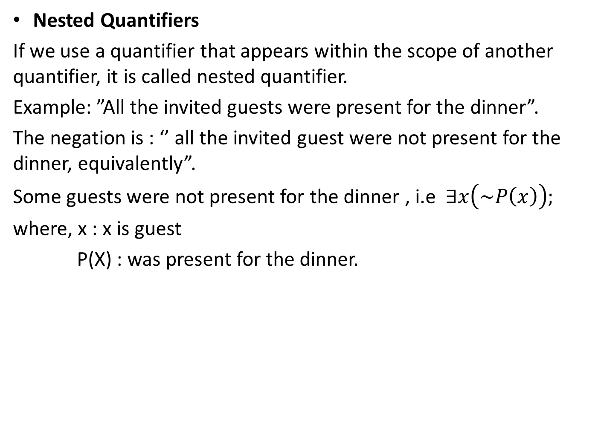
Nested Quantifiers
If we use a quantifier that appears within the scope of another quantifier, it is called nested quantifier.
Example: ”All the invited guests were present for the dinner”.
The negation is : ‘’ all the invited guest were not present for the dinner, equivalently”.
Some guests were not present for the dinner , i.e $∃x\left(\sim P\left(x\right)\right);$
where, x : x is guest
P(X) : was present for the dinner.

